Slide 1
Supermarket Project
Face Reidentification + Object Detection

Slide 2
Task
Face Reidentification
Data: Few images of Jean / Prof Daniel
Detect + Classify faces
Video Input
Object Detection
Data: None
Detect a list of objects and count
Image Input
Notes:
The project is split into 2 tasks: Face Reidentification and Object Detection. For face reidentification, we only have a few images of Jean / Prof Daniel which means we would have to use a pretrained network.
What we can capitalise on is the fact that we are using a video input, where we make use of temporal consistency to improve accuracy. Temporal consistency will be explained later.
For object detection, the main challenge is the lack of data. We are working with image inputs which means standard image object detection should be used.

Slide 3
Face Reidentification
Facenet: https://github.com/timesler/facenet-pytorch
My Repo: https://github.com/PTMZ/Face-Reidentification
MTCNN (Face Detection) and InceptionResnet (Feature Extraction)
Cosine Similarity vs Euclidean Distance
Video Input vs Image Input
Consecutive frames are similar
Temporal Consistency
Notes:
The first 2 are links to the base pretrained network we used. My repository explains how to use it.
The original pipeline consists of 2 main stages.
First it goes through the Multi-Task CNN (MTCNN) which identifies bounding boxes for faces in the image.
The next stage it goes through InceptionResnet which outputs a Feature vector for each face detected in the previous stage.
To classify a face, we compare it with feature vectors computed on a database of images, and use cosine similarity rather than Euclidean distance. I will explain why so in the next slide.
The video input also allows us to use the fact that consecutive frames are very similar, hence we can make better predictions by stacking information over multiple frames. This will be explained after the next slide.

Slide 4
Cosine Similarity vs Euclidean Distance
0.1
0.1 * k
-0.2
-0.2 * k
0.4
0.4 * k
Feature
Vector
Logits
Feature
Vector * k
Logits
Ref.
A
B
Which vector, A or B, will have a more similar prediction to Ref?
Notes:
After testing I found that cosine similarity performs better than Euclidean distance. Why is this the case?
Let’s see how the InceptionResnet was trained. To classify, InceptionResnet will pass the Feature Vector into a Linear layer to output scores for each class.
The argmax of the output logits will be the final prediction.
Notice that if we scale the Feature vector by some positive value k, the output logits will scale accordingly, which means the argmax will remain the same.
Hence, the magnitude of the feature vector should be ignored when comparing how similar 2 feature vectors are.
Hence, Cosine Similarity is a better measure than Euclidean Distance.
If we look at the example below, A will have a closer prediction to Ref than B, even though B is closer to Ref than A in terms of Euclidean Distance.

Slide 5
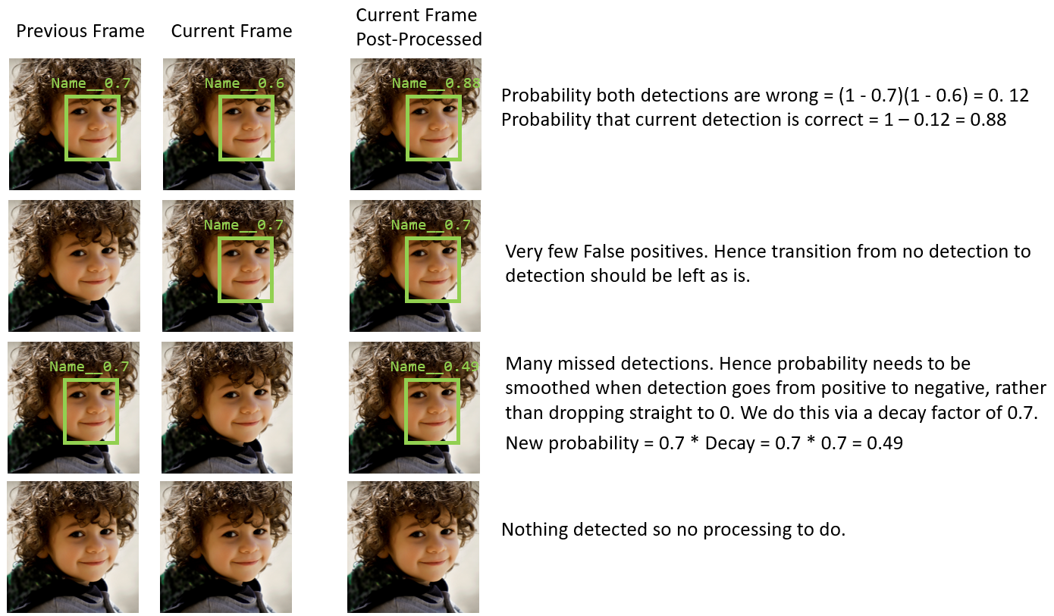
Notes:
Now I’ll explain the temporal consistency added to the original network.
The first 2 columns show the 4 possibilities between 2 consecutive frames and what is detected and their probabilities.
The 3rd column shows the post-processed frame after temporal consistency is applied and will replace the labels in the current frame.
For the first row, we have a face detected in both frames. Since the network has detected a face in both consecutive frames, we can increase our confidence that the face detected is there.
We do this by considering the 2 face detections as independent, and computing the probability that both detections are wrong. Then compute the probability it is correct by subtracting the previous result from 1.
The 2nd row shows what happens if we have a negative detection followed by a positive detection. IN this case, No processing is done as we have very few false positives and hence any positive detected should be left as such.
The 3rd row shows what happens when a face is detected in the previous frame but not detected in the current frame. Because our model has many missed detections (False negatives), we should smooth out the probability that it really is a negative detection by applying a decay factor to the previous probability, rather than dropping the probability of seeing the face to 0 straight.
Last row is the case where nothing is seen. No processing to do.

Slide 6
Object Detection
YOLOv5: https://github.com/ultralytics/yolov5
My Repo: https://github.com/PTMZ/YOLO-Dataset-Generator
Main challenge: Data
Quantity + Quality
Data Generator
Generate Images with Objects listed + Noise objects
Generate corresponding YOLO labels
Notes:
For the object detection task, we used YoloV5 for our base pretrained network. The main challenge for this task was data, and the data problem has 2 main concerns.
Quantity: It would be extremely time consuming to take multiple pics of various positions of objects + noise objects, and label them after.
Quality: We can only buy so many different variations of apples / bananas / whatever. Our dataset in terms of variety regardless of size would be bad if we simply chose to manually takes pics and label them.
Solution: Data generator to generate both images contained the objects to detect + noise and the Yolo labels for training.

Slide 7
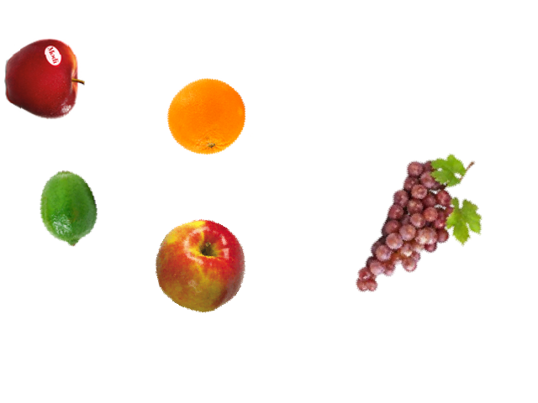
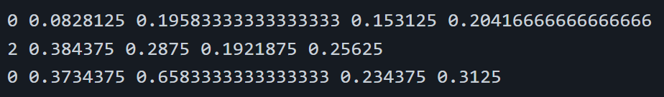
classes = [“apples”, “bananas”, “oranges”]
class | X | Y | W | H
0 | 0.083 | 0.196 | 0.153 | 0.204
2 | 0.384 | 0.288 | 0.192 | 0.256
0 | 0.373 | 0.658 | 0.234 | 0.313
Notes:
Explaining the outputs generated by the dataset generator. On the left is an image generated by the script.
On the right I simplified the case to 3 objects: apples bananas and oranges, in this order. Hence apples are labelled class 0, bananas 1 and oranges 2.
The output txt label file consists of 5 columns, first column telling me the class label, and the following 4 are the X position, Y position, Width and Height respectively.
The numbers for these 4 columns are relative to the image size, where X and Y are relative to the top left corner set as (0,0) and the bottom right corner as (1,1).
Similarly, Width and Height use the same relative size where Width is the relative width with respect to the entire width of the image.

Slide 8
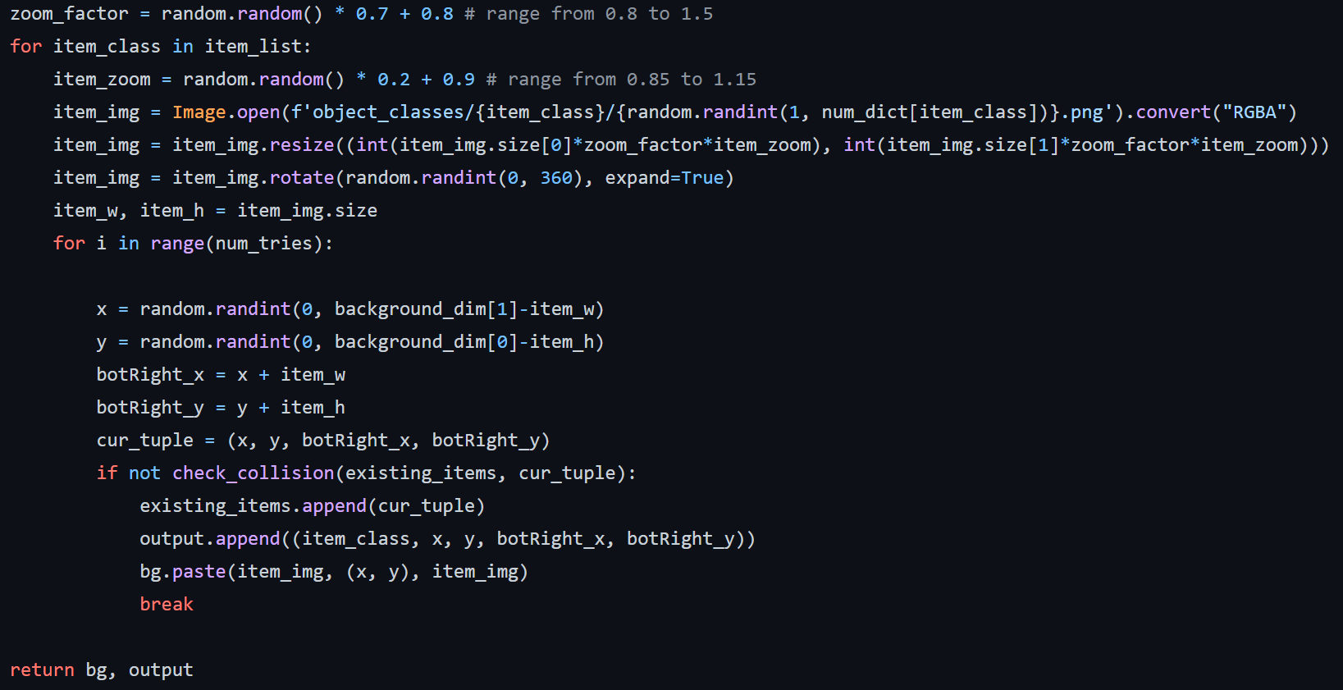


Overlapping Items
Notes:
Lastly, our data generator should not just randomly add objects to the image without considering overlaps, as one of the constraints was that objects would not overlap one another.
This means that before placing an object in an image, we should consider the overlap between objects. This is done by computing the overlappy area between bounding boxes, also known as Intersection over Union (IoU).
This is what the check_collision method does on the right. If IoU is more than 0 between the current item and any existing item in the image, it will return True,
The code on the right also show the various operations on the objects, using random rotate, resize, and position.

